Slide 1

DATAFISH
Luz Ayda Lozano L
Germán Benavides C

Slide 2
1. Billfish Foundation
The key biological measurements required for fish stock assessment are:
Different types of Fish Species Caught
Number of each fish species caught
Length of individual fish within a species

Slide 3
The target
We need a tool that can enable non-experts to carry out fisheries data collection from measurement to statistic without human intervention and internet access.

Slide 4
The motivation: “… a function that helps non-experts to identify species correctly would be extremely valuable” Fishackathon 2016 Problem Statements pag 3

Slide 5
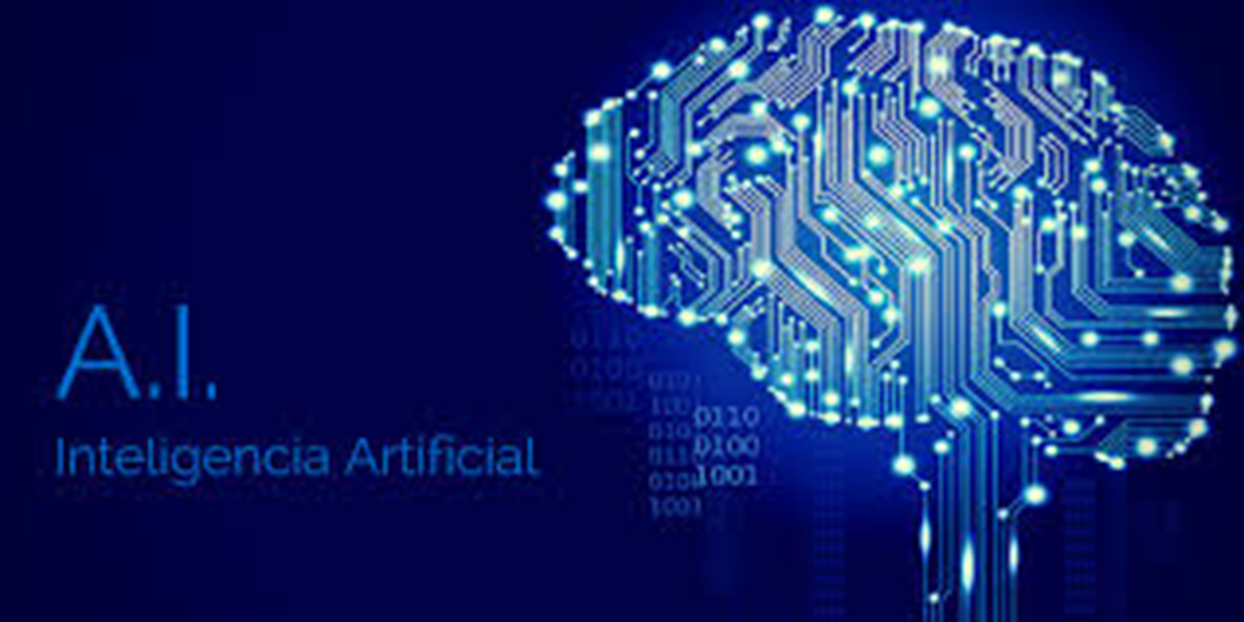
REDES NEURONALES
ARTIFICIALES

Slide 6
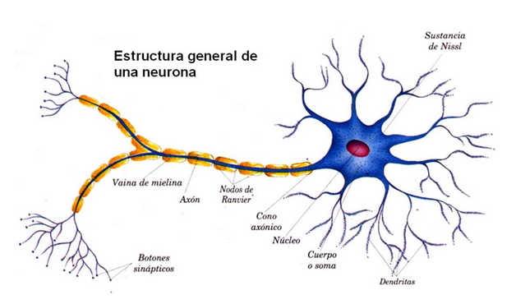
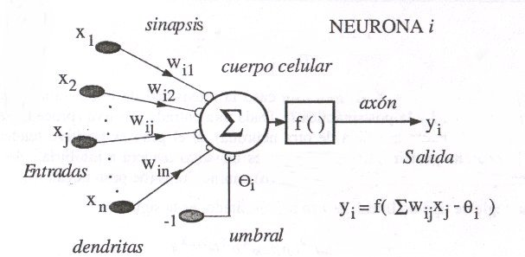

Slide 8
Data set

Slide 9
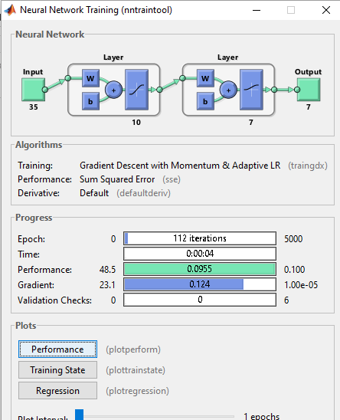
Neural Network Trainning

Slide 10
Operation: Only 3 step
Neural Network Training (only once)
Image capture (from data set or still camera)
Identification of fish specie (automated system)

Slide 11
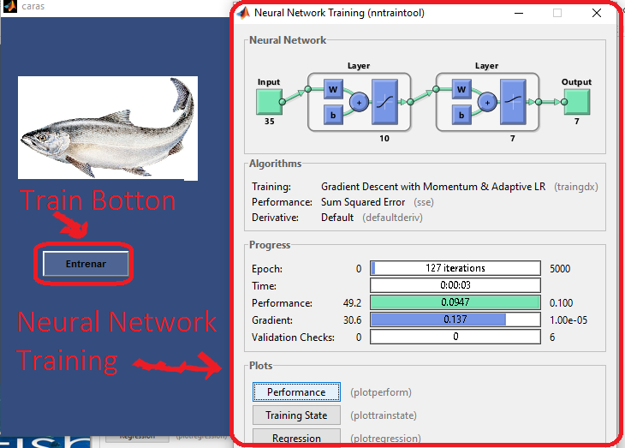
1. Neural Network Trainning

Slide 12
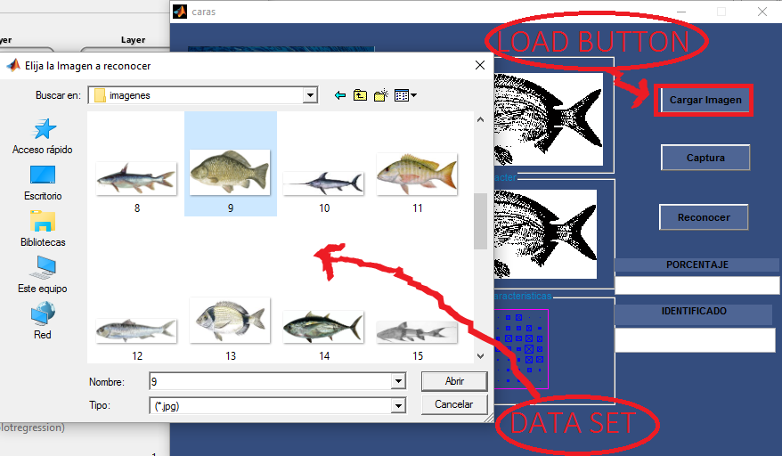
2. Image capture: from data set

Slide 13
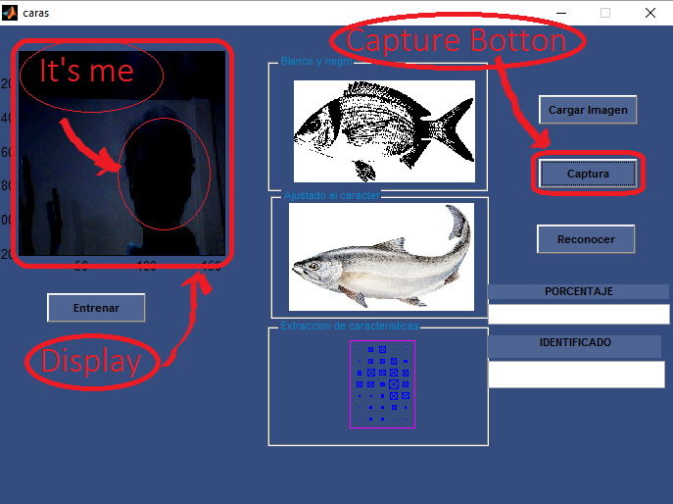
2. Or Image capture: from camera (in real time)

Slide 14
3. Identification of fish specie (only push Identify Botton)

Slide 15
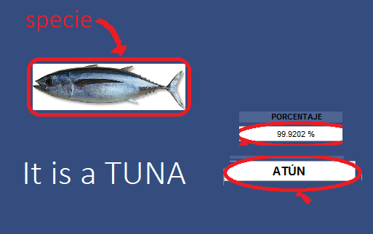
That’s it

Slide 16
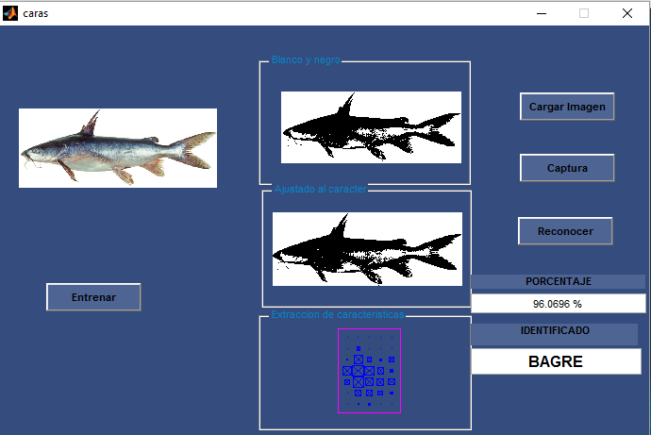
Some results: Catfish 99.06%

Slide 17
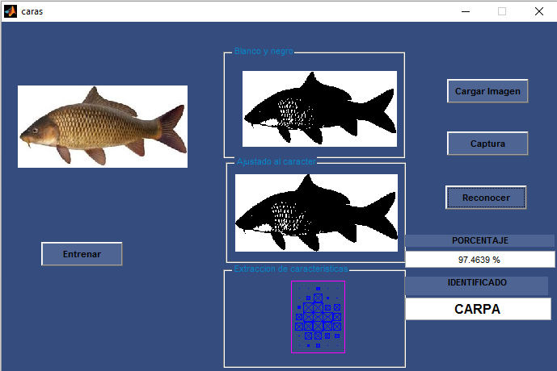
Some results: Carp 97.46%

Slide 18
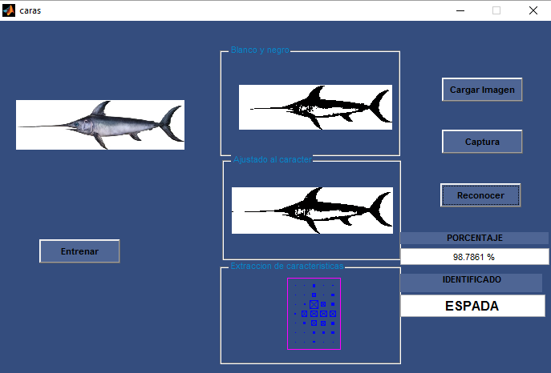
Some results: Swordfish 98.78 %

Slide 19
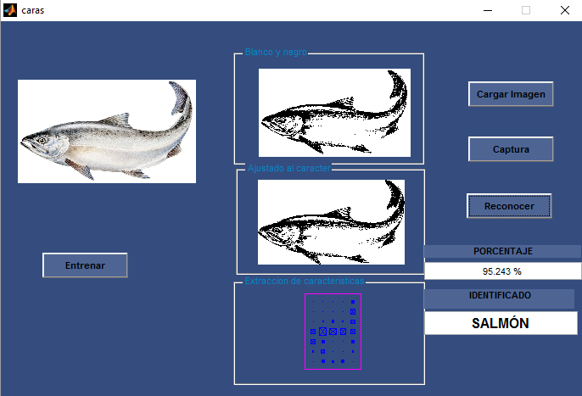
Some results: Salmon 95.24 %

Slide 20
¿What happens if a fish no this in data set?

Slide 21
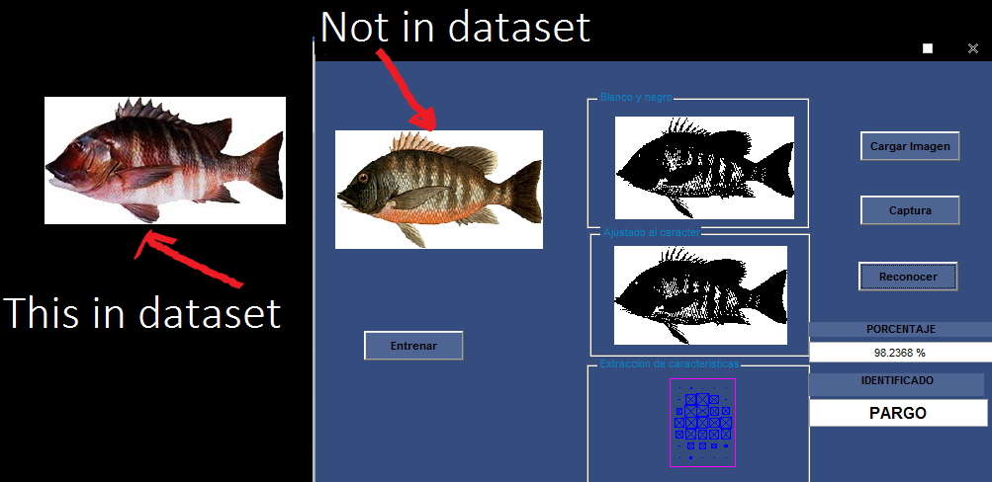
No problem: Pargo 98.23 %

Slide 22
¿What happens if some characteristic change?

Slide 23
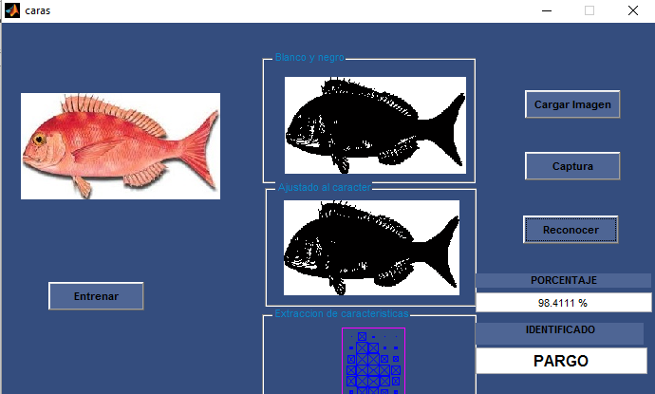
1. Pargo 98.41 %

Slide 24
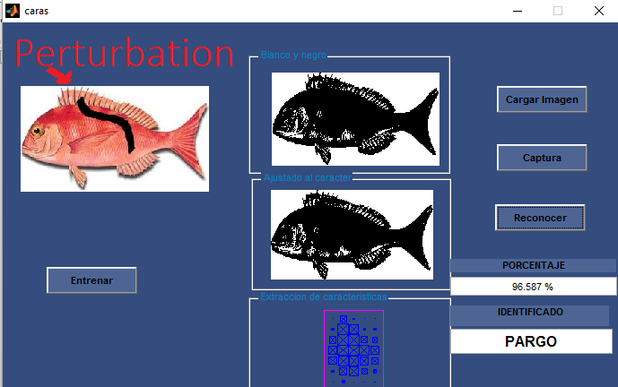
2. Pargo 96.58 %

Slide 25
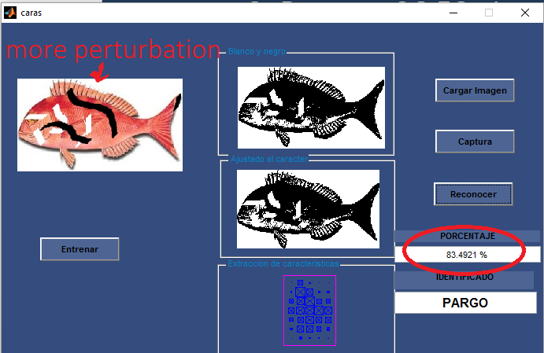
3. Pargo 83.49 %

Slide 26
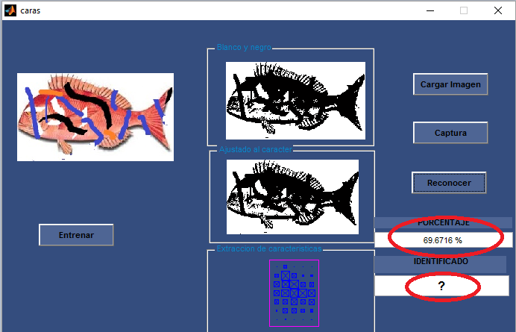
3.Unrecognizable ?

Slide 27
Automated measurement :Length of individual fish tool
The challenge ->

Slide 28
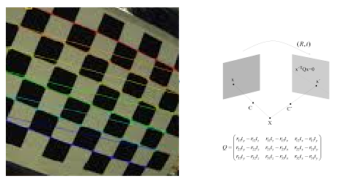
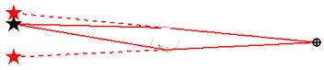
Solution: Camera Calibration and Laser Reference Pattern

Slide 29
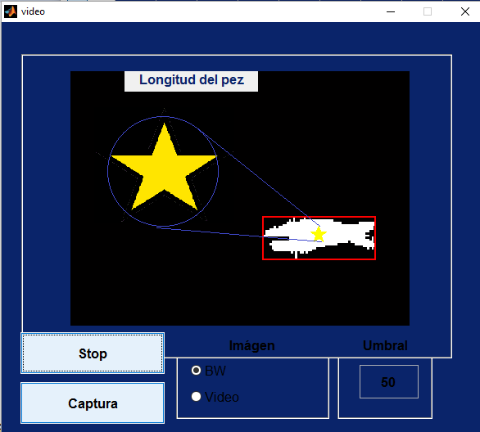
Solution

Slide 30
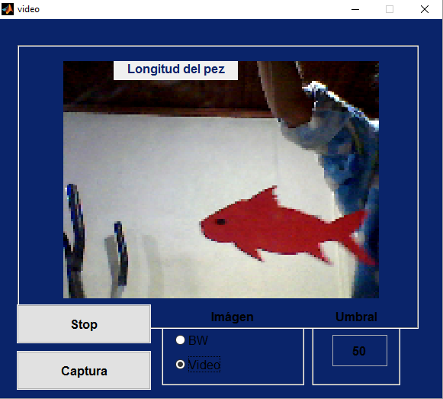
Testing the application in real time

Slide 31
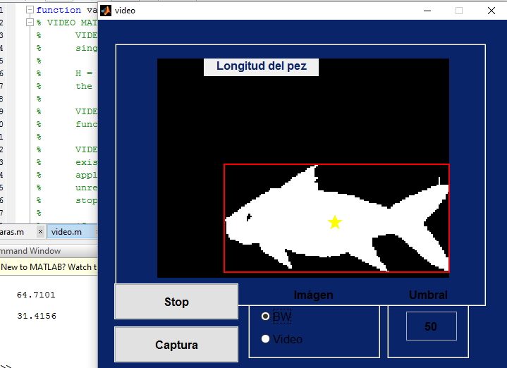
Result
Width and height

Slide 32
Conclusions
We build a tool that can enable non-experts to carry out fisheries data collection from measurement to statistic without human intervention and internet access.

Slide 33
Features
Image capture from either data set or camera
Identification of fish species (automate)
Potentially also Record sex crabs/lobsters (crustaceans) (automated/user input)
Automated measurement of biometric data (Length, breadth)
Potentially with position, time, date (Geostamping)
Server /client or not internet acces
Fishermen and tourist becomes researchers

